Slide 1
Linear Algebra
Lecture 28

Slide 2
Eigenvalues and
Eigenvectors

Slide 3
Fixed Points

Slide 4
Theorem
If A is an n x n matrix, then the following statements are equivalent.
(a) A has nontrivial fixed points.
(b) I – A is singular.
(c) det(I – A) = 0

Slide 5
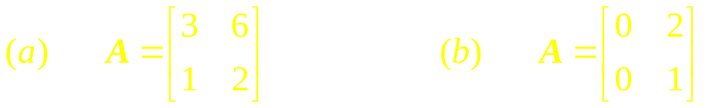
Example 1
In each part, determine whether the matrix has nontrivial fixed points; and, if so, graph the subspace of fixed points in an xy-coordinate system.

Slide 6
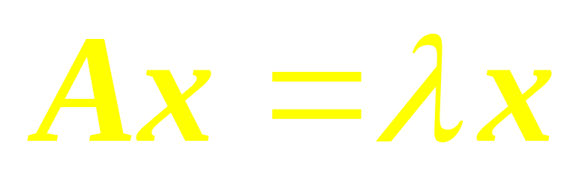
Problem
If A is an n x n matrix, for what values of the scalar, if any, are there nonzero vectors in R^{n} such that

Slide 7

Definition
If A is an n x n matrix, then a scalar is called an eigenvalue of A if there is a nonzero vector x such that Ax = x.
…

Slide 8
Definition
If is an eigenvalue of A, then every nonzero vector x such that Ax = x is called an eigenvector of A corresponding to .

Slide 9
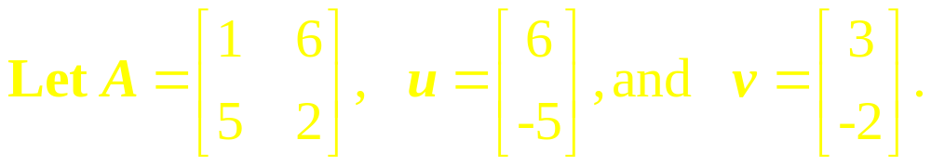
Example 2
Are u and v eigenvectors of A?

Slide 10
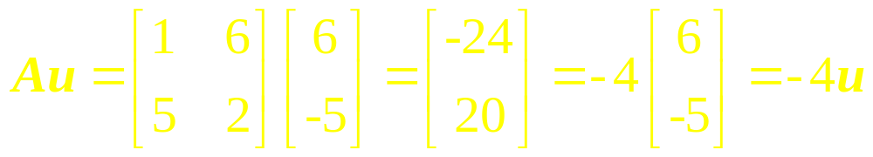
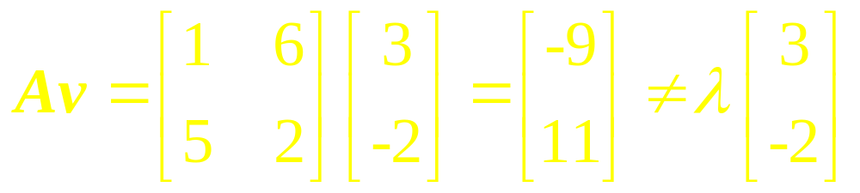
Solution

Slide 11
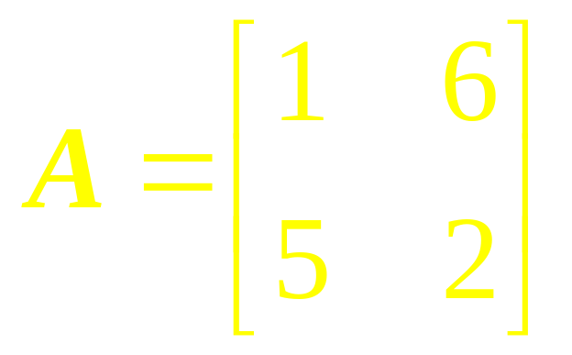
Example 3
Show that 7 is an eigenvalue of the matrix A and find the corresponding eigenvectors,
where

Slide 12
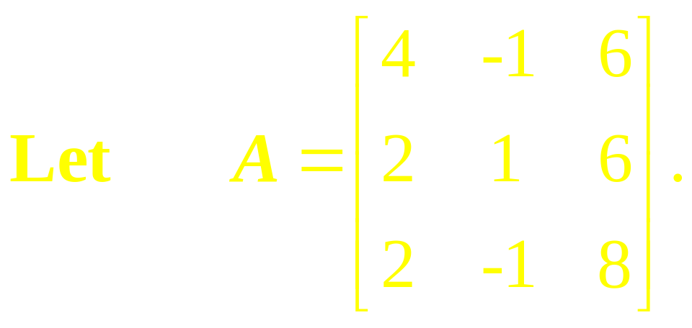
Example 4
An eigenvalue of A is 2. Find a basis for the corresponding eigenspace.

Slide 13

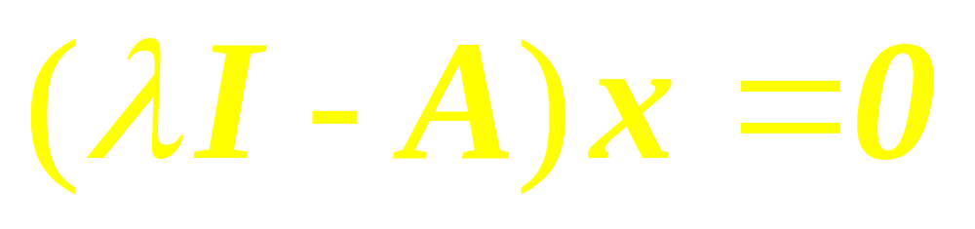
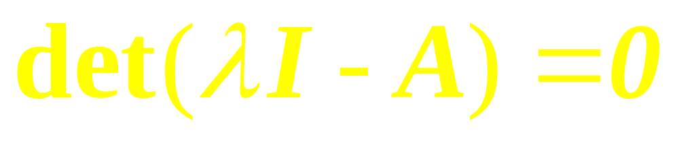
Observe

Slide 14
Theorem
If A is an n x n matrix and is a scalar, then the following statements are equivalent.
(i) is an eigenvalue of A.

Slide 15
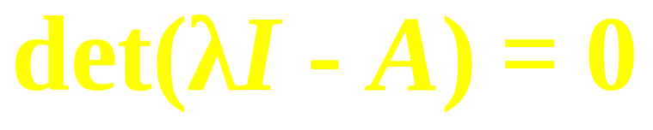
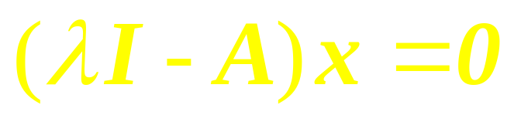
Theorem
(ii) is a solution of the equation
(iii) The linear system
has nontrivial solutions.

Slide 16
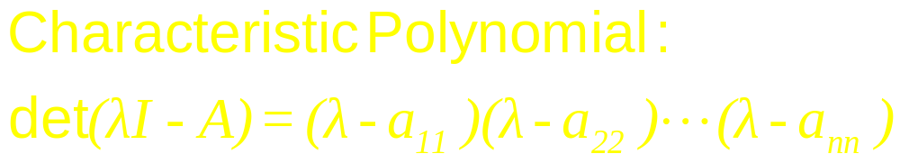
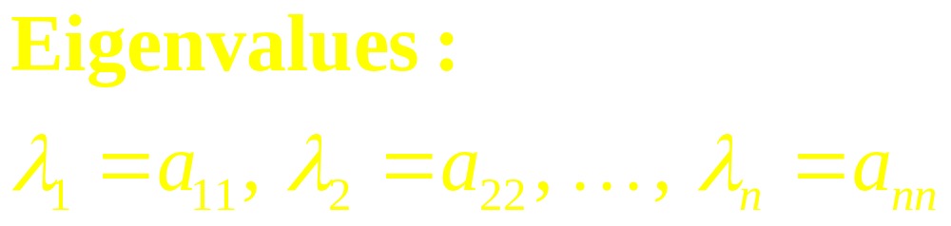
Eigenvalues of Triangular Matrices

Slide 17
Theorem
If A is a triangular matrix (upper triangular, lower triangular, or diagonal) then the eigenvalues of A are the entries on the main diagonal of A.

Slide 18
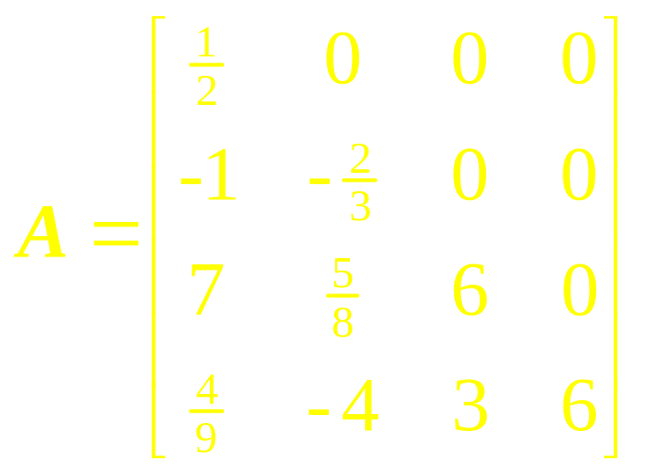
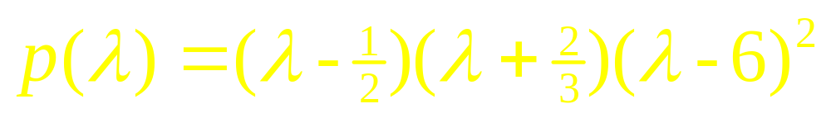
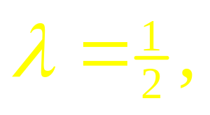
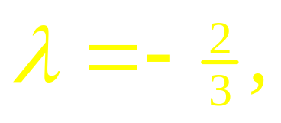
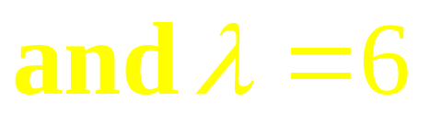
Example 5

Slide 19
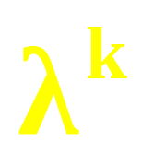
Theorem
If is an eigenvalue of a matrix A and x is a corresponding eigenvector, and if k is any positive integer, then is an eigenvalue of A^{k} and x is a corresponding eigenvector.

Slide 20
A Unifying Theorem

Slide 21
Example 6

Slide 22
Linear Algebra
Lecture 28

